Slide 1
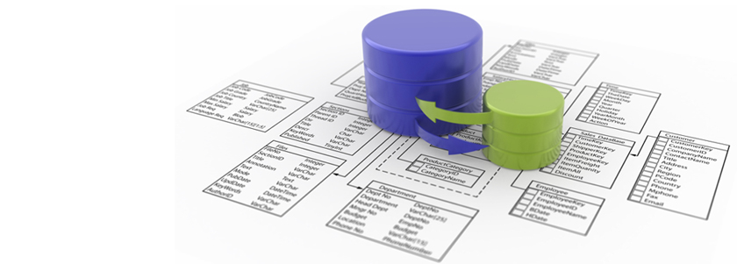
Introduction to Databases

Slide 2
What is a database?
A database program is nothing more than a set of information held in the computer
A database is defined by the fact that it is
A collection of related information
And that information is related by a “common denominator”

Slide 3
What is a database?
Electronic database software is more efficient than the traditional systems because:
Enter data quickly and easily
Organize records in different ways
Locate specific records quickly
Eliminate duplicate data
Create relationships among tables in a database
Create reports
Change the appearance of information

Slide 4
Spreadsheet vs. Database?
Both can manipulate data mathematically
Both can have information organized in row/column format
Spreadsheets: this is the only view
Databases: multiple ways to view information
Both can sort information
Spreadsheets: must highlight all or will lose data
Databases: can just select column; will maintain data
Database information can be searched; therefore you can deal with subsets of information

Slide 5
Example
LHS Student Profile
Student ID
First Name
Last Name
Address
City
State
Zip
Home Phone #
Parent 1 Name
Parent 1 Contact #
Parent 2 Name
Parent 2 Contact #
Accommodations
Extra curricular activities
Freshman Class Schedule
Freshman Grades
Sophomore Class Schedule
Sophomore Grades
Junior Class Schedule
Junior Grades
Senior Class Schedule
Senior Grades
Cumulative Grade Point Average
Attendance Records
Dues Owed
Discipline
AP
Counselor

Slide 6
LHS Student Profile
With a Database you can:
Have one master database
But specify what information you are interested in:
i.e. All Juniors that play a sport, have a 3.0 grade point average or better, that have taken BIM, and received at least an 85 in the class
And streamline it for your particular needs

Slide 7
How do databases work?
Databases are made up of objects that:
Store your data
Allow you to enter data
Allow you to view data
Allow you to ask questions about the data in your database
And present your data in easily understood format

Slide 8
Database Objects
Tables
Like a spreadsheet
Used to create the database
Forms
Used for data input, display and for controlling the use of the database
Queries
Way to retrieve selected information from one or more Tables
Reports
Used for formatting, calculating, printing, and summarizing selected data

Slide 9
Before you begin…
The Key to a good database is PLANNING!
What is the primary purpose of your database?
What other ways can your database be used?
Who will have access to your database?
What categories of information need to be included in your database
What kind of information will be stored in each category?

Slide 10
Database Terminology
Field – one piece of data
872 Foxglove Ct.
Record – a collection of fields on one person or item
Student Name, Address, Contact Information, etc.
File – a collection of related records
BIM 2nd
Database – a collection of related files
All BIM Classes
Primary Key – field that is unique to each record
Student ID

Slide 11
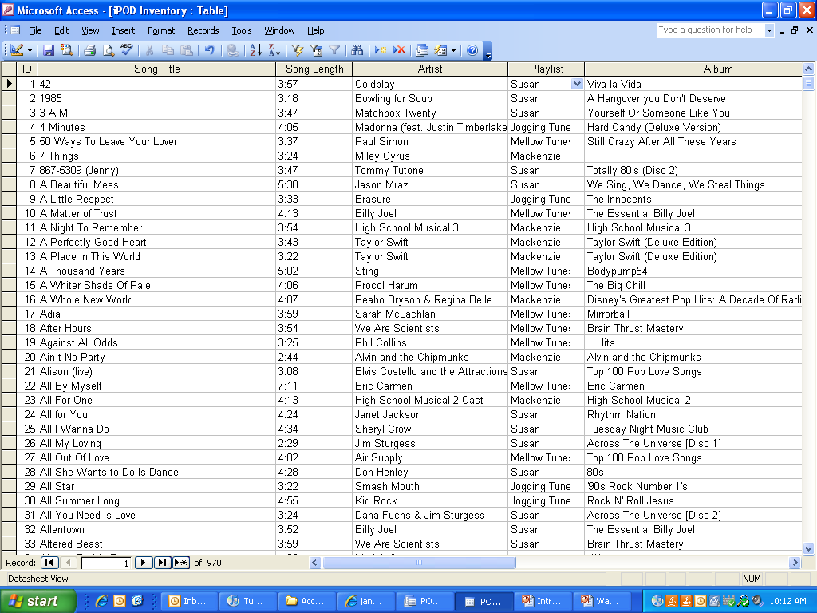
Actual Database
Fields?

Slide 12
Actual Database
Records?

Slide 13
Actual Database
File?

Slide 14
Access Index Card
Student ID
First Name
Last Name
Address
City
State
Zip Code

